Slide 1
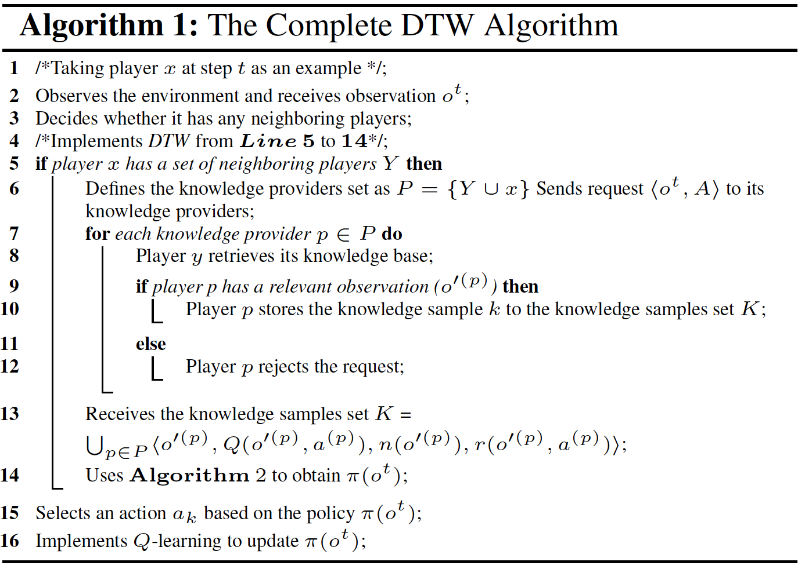
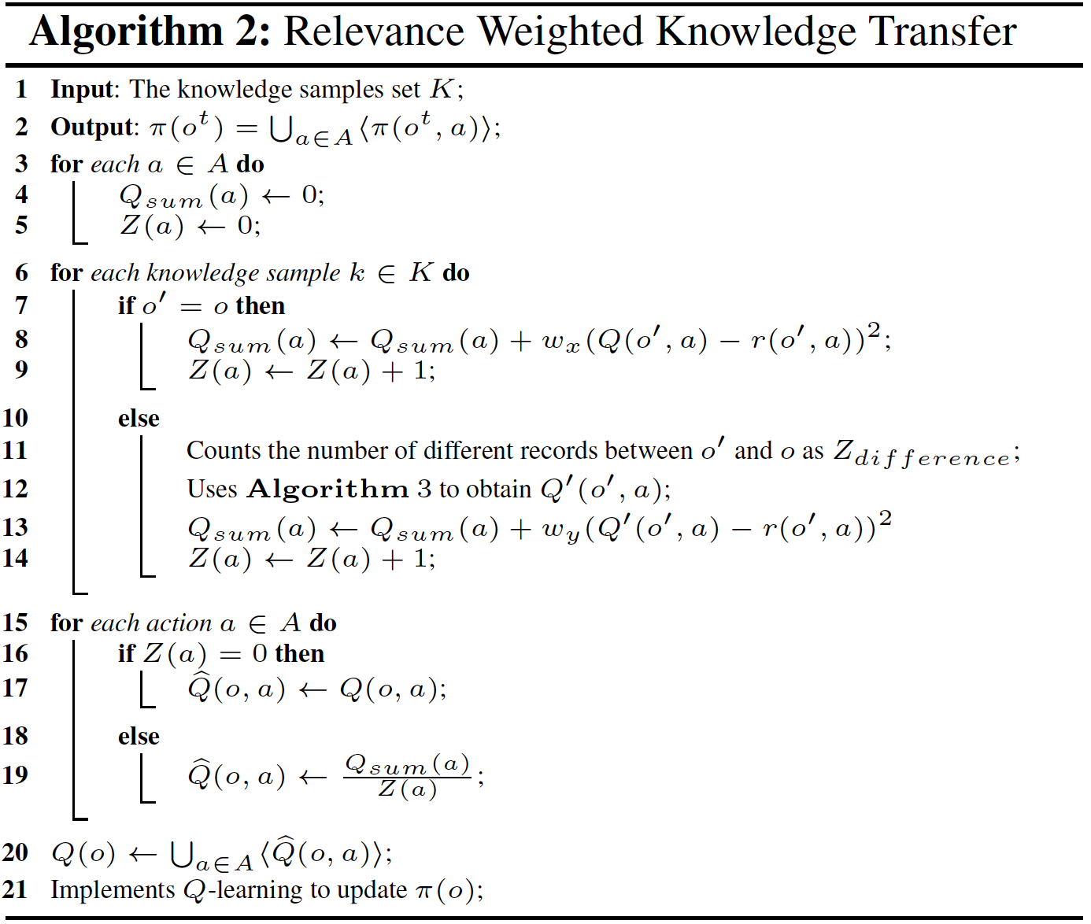
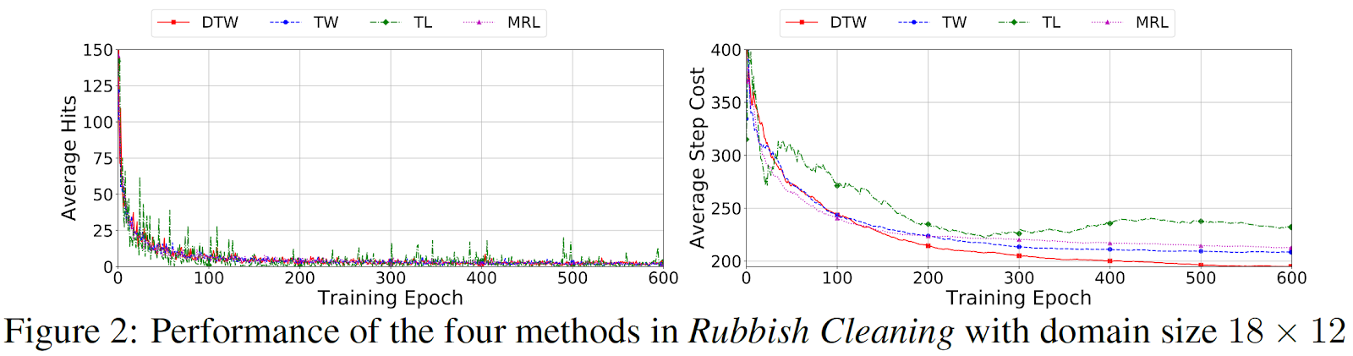
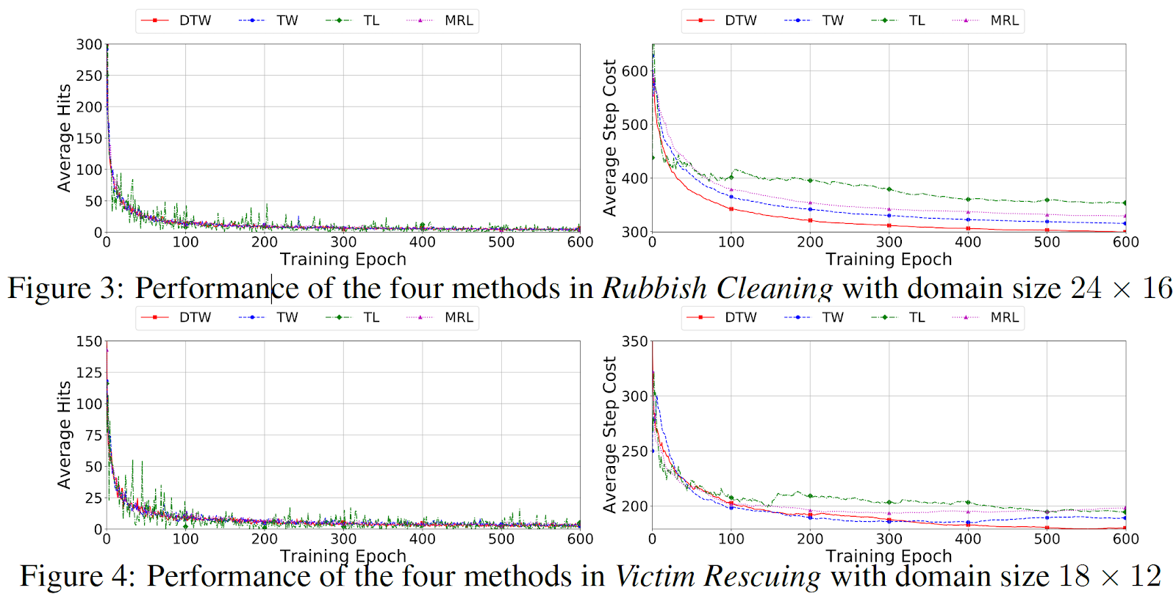
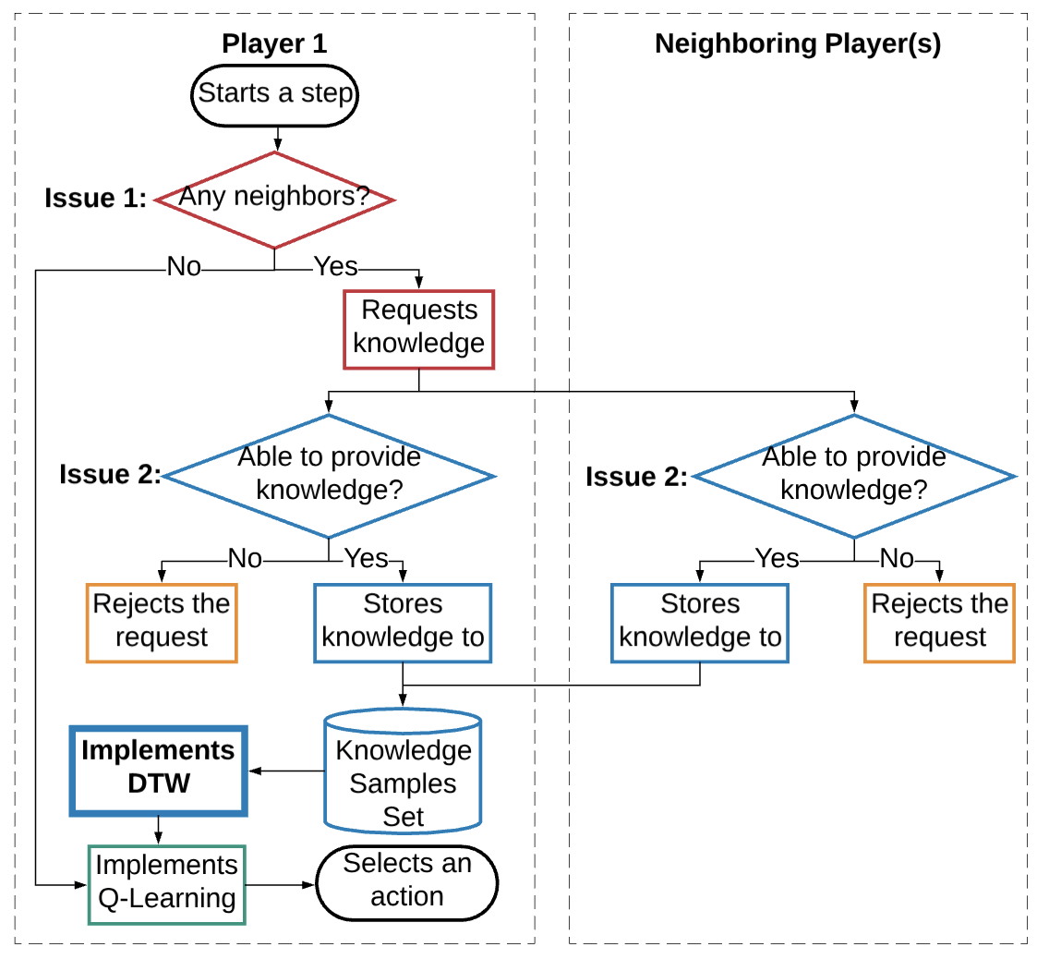
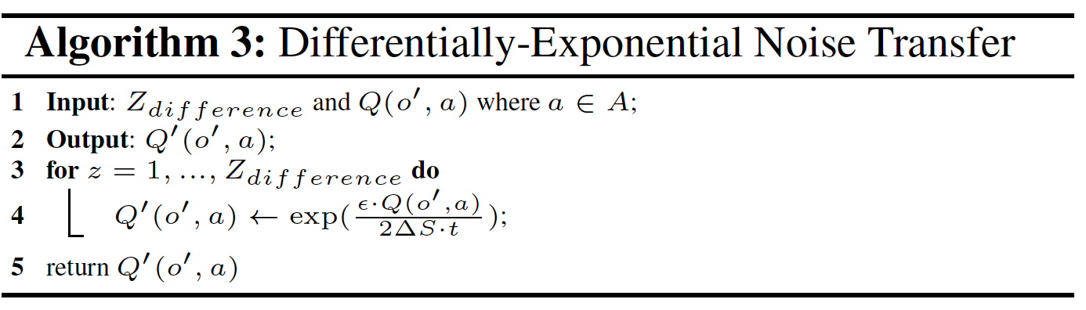
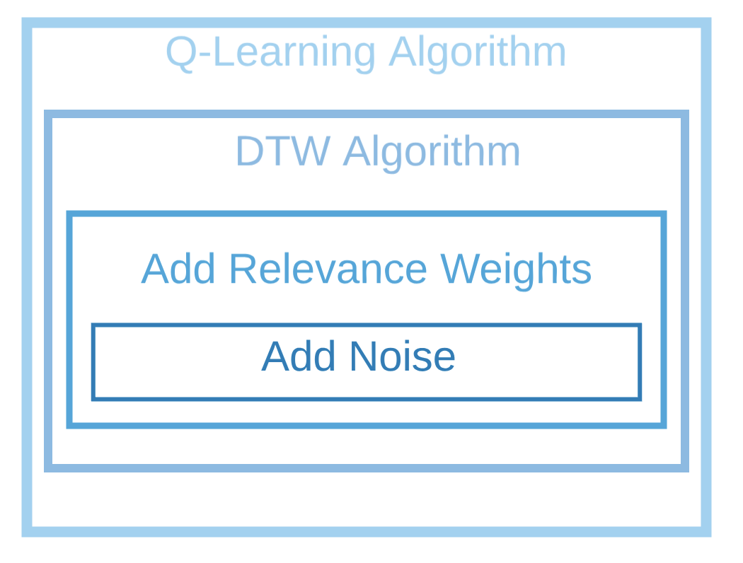
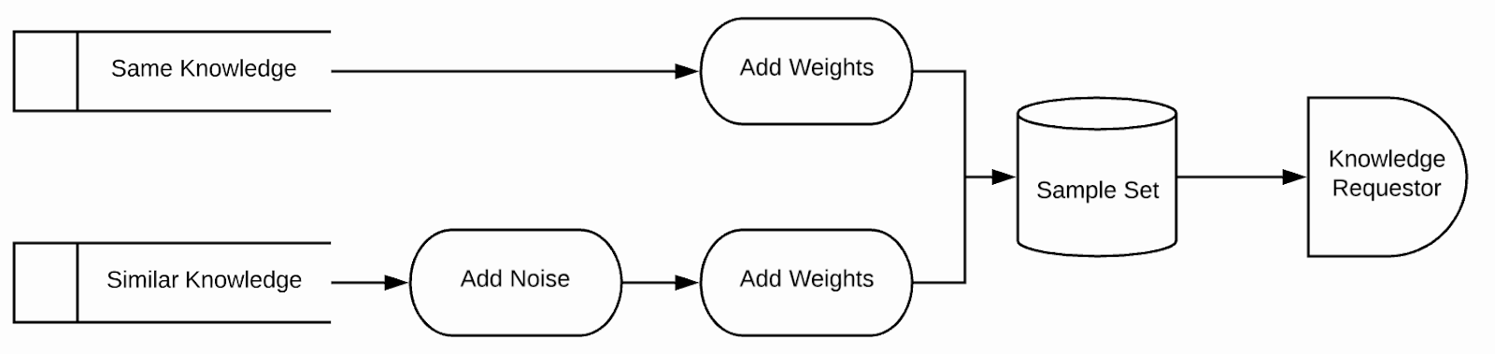
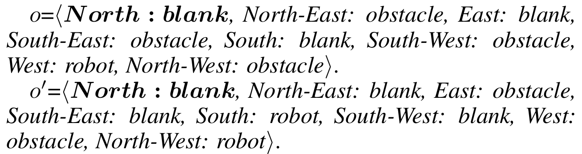
Multi-Agent Reinforcement Learning via Knowledge Transfer with Differential Noise and Relevance Weights
Zishuo Cheng, Dayong Ye, Tianqing Zhu, Wanlei Zhou, Philip Yu
University of Technology Sydney, School of Software
Abstract
Advantages of DTW:
DTW is applicable to partially-observable environments;
DTW does not require sample pre-collection, but instead collects samples in an online manner;
DTW improves transfer learning performance from by augmenting sample size and further enhancing the robustness of negative transfer.
Algorithms:
In multi-agent reinforcement learning, there are three challenges to apply transfer learning in reinforcement learning in order to speed up the learning performance. Firstly, most real-world environments are partially rather than fully observable. Secondly, knowledge samples are difficult to be pre-collected in unknown environments. Thirdly, negative transfer impedes the learning progress. We observe that differentially private mechanisms can overcome the last two challenges due to their randomisation properties. Therefore, we propose a novel differential transfer learning method for multi-agent reinforcement learning to overcome these three challenges. Moreover, we implement two experiments to demonstrate the effectiveness of our proposed method.
Methodology
Algorithm Structure:
We develop DTW embedded into the Q-learning algorithm
to augment sample size and overcome negative transfer.
Work flow of each player at a Step:
Introduction
Experiments
Multi-agent reinforcement learning (MRL) is a learning process that enables multiple participants to learn appropriate behaviours in an interactive environment [Sutton and Barto, 2018]. For MRL, one of the essential aspects of performance evaluations is the learning effectiveness, which can be significantly improved by transfer learning. This paper focuses on the problem of how to transfer the relevant knowledge samples from player 1 to augment the knowledge set of player 2 and guarantee the quality of transferred sample in this process.
Drawbacks of existing methods knowledge samples transfer:
existing methods are developed in fully observable environments;
existing methods assume that samples have already been collected; and
existing methods do not fully exploit the similarity between sample tasks and target tasks so that negative transfer remains probable.
Challenges:
in partially observable environments, each player receives observations only about areas in the vicinity, and making the different observations useful between players is a challenging.
in some unknown environments, it may be impossible to pre-collect relevant samples.
further decreasing the interference of negative transfer in a more complex environment is a challenging issue.
We develop a novel method for transferring knowledge samples. We refer to this method as differential knowledge transfer with relevance weight, or DTW. This method is designed from a new and atypical perspective in that it incorporates differential privacy mechanism.
Differential privacy is a privacy model that guarantees that an individual record being stored in or removed from a dataset will make little difference to the an analytical output of the dataset [Dwork, 2006]. This property of differential privacy can be used in our work to guarantee that the knowledge embodied in an observation can still be used for another different observation if the two observations differ in at most one record.
Two different domains with increasing levels of complexity:
Rubbish Cleaning is a domain contains a fixed amount of rubbish and obstacles in fixed positions; and
Victim Rescuing is a domain contains a fixed amount of obstacles in fixed positions and a fixed number of victims moving dynamically.
The domain size varies from 18X12 grids to 24X16 grids, and the number of players, targets, and obstacles vary from 4 to 6, 40 to 80, and 25 to 45.
Four bench mark algorithms:
random, denoted as Random;
multi-agent reinforcement learning, denoted as MRL, is a Q-learning algorithm for POMDP;
knowledge transfer in reinforcement learning, denoted as TL, is a transfer learning without weights and noise; and
knowledge transfer with relevance weights, denoted as TW is a TL method with relevance weights only.
The parameters setting:
⍺ = 0.2, 𝛾 = 0.85, 𝜁 = 0.1, 𝛥S = 3, and 𝝐 = 1. The rewards given to a player for moving a step, reaching a target, and hitting an obstacle were set to 0, 10 and -5, respectively.
Related Works
Work flow of knowledge transfer:
Lazaric et al. [2008] develop an algorithm to transfer samples from source tasks to target tasks. Their algorithm selects samples from the source tasks that are the most similar to a target task. Lazaric and Restelli [2011] propose three sample-transfer algorithms based on fitted Q-iteration. The authors then analyse the relevance of the average MDP (Markov decision process) obtained by combining the source tasks. Laroche and Barlier [2017] develop a transfer reinforcement learning method underpinned by two main concepts. The first concept is that transition samples obtained from a task can be used in other tasks; the second involves adopting the, optimism in the face of uncertainty, principle and using upper bound reward estimates. while only the reward function does. Tirinzoni et al. [2018] propose an approach for the transfer of samples in reinforcement learning. These samples are prioritised based on their relevance weights, which is estimated using a model-based technique. All these methods are proposed in fully observable environments and require pre-collected samples from source tasks.
Definition of similar knowledge:
If two observation have at least ONE common record, they are similar to each other. For example:
The similarity between o and o’ is 1/8.
Method overview:
If a player does not observe any neighbours, it moves based on its own knowledge by implementing the Q-learning algorithm. Once the player observes one or more neighbours, it begins to play the role of a knowledge requestor who sends a request message to its neighbours asking for knowledge samples.
If a player receives a request message, it begins to play the role of a knowledge provider. Knowledge providers firstly retrieve their own knowledge base. If they do not have any knowledge samples, they reject the request. If they do have knowledge samples, they store these samples to a knowledge samples set. Additionally, to further increase the size of samples set, the knowledge requestor also stores its own knowledge samples to the knowledge samples set to facilitate self-transfer learning.
After the knowledge samples set has been collected, those samples cannot be used directly by the knowledge requestor due to the potential for negative transfer. Therefore, the knowledge requestor firstly implements the DTW to add relevance weights and differentially-exponential noise into the knowledge samples, and then learns from the processed outcome. Finally, the knowledge requestor implements the Q-learning based on the transferred knowledge.
Results Discussion
Conclusion
In all three experiments, TL performed only better than Random and even worse than MRL on average. This demonstrates that implementing a transfer learning method which just simply augments sample size without taking negative transfer learning into account in MRL cannot improve learning performance.
The average step cost required with TW was 2% ~ 4.5% fewer than MRL and 40% ~ 54% fewer than Random. This shows that transfer learning with relevance weights is an effective way to optimise the learning performance of MRL algorithm.
The average step cost required with DTW was 8.5% ~ 9.5% fewer than MRL and 44% ~ 56% fewer than Random. DTW also costed 5% fewer steps than TW. This illustrates that in some more complex scenarios, such as partially-observable environments required with online knowledge transfer, the improvement by adding relevance weight in transfer learning becomes lower. In this context, implementing differentially private techniques can further improve the outcomes.
In this paper, we propose DTW, which is a novel transfer learning method with differential noise and relevance weights for multi-agent reinforcement learning. To our knowledge, this method is the first to jointly apply differential noise and relevance weights to knowledge transfer among multiple players in a partially-observable environment. In addition, compared to existing methods, DTW enables to not only augment the sample sizes but also further improve the robustness of negative transfer. Finally, we implement DTW in two experimental environments at the same time of augmenting the sample sizes. The experimental results indicate that DTW outperforms the benchmark methods in numerous aspects.

